Slide 1
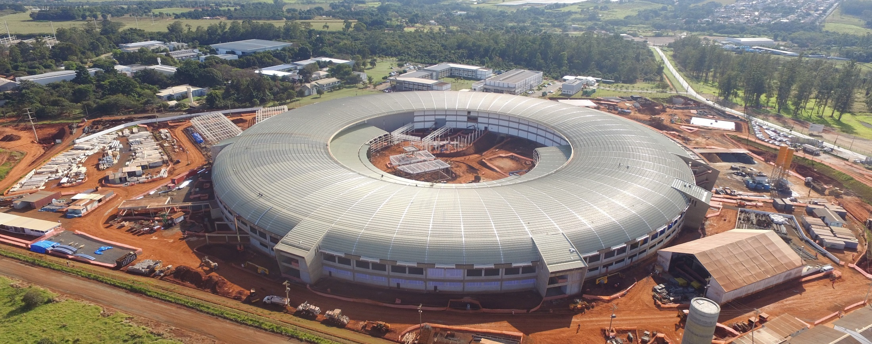
Studies of collective effects for Sirius
Fernando Henrique de Sá
Accelerator Physics Group
Brazilian Synchrotron Light Laboratory (LNLS)
fernando.sa@lnls.br

Slide 2
Sirius, the Brazilian Light Source Project
First beam 2018 – Open in 2019
Budget
Accelerators 100 M US$
13 beamlines 140 M US$
Building 213 M US$
Human Res 57 M US$
Total 510 M US$
Schedule
Jan.2015 start of building construction
Oct.2017 start of Linac installation
Jul.2018 start of SR commissioning
Sep.2018 phase 1 operation (20mA, NCC)
Feb.2019 phase 2 operaton (100mA, SCC)

Slide 3
Sirius main parameters
Sirius Main Parameters
Beam energy | 3.0 GeV
Circumference | 518.4 m
Revolution Frequency | 578.3 kHz
Harmonic Number | 864
RF Voltage | 3 MV
tunes (H / V / L) | 49.11 / 14.17 / 4.6 x 10⁻³
Momentum Compaction | 1.7 x 10⁻⁴
Natural bunch length | 2.4 mm
Natural energy spread | 8.0 x 10⁻⁴
Energy loss/turn (dipoles) | 472 keV
Damping times (H/V/L) | 16.9 / 22.0 / 12.9 ms

Slide 4
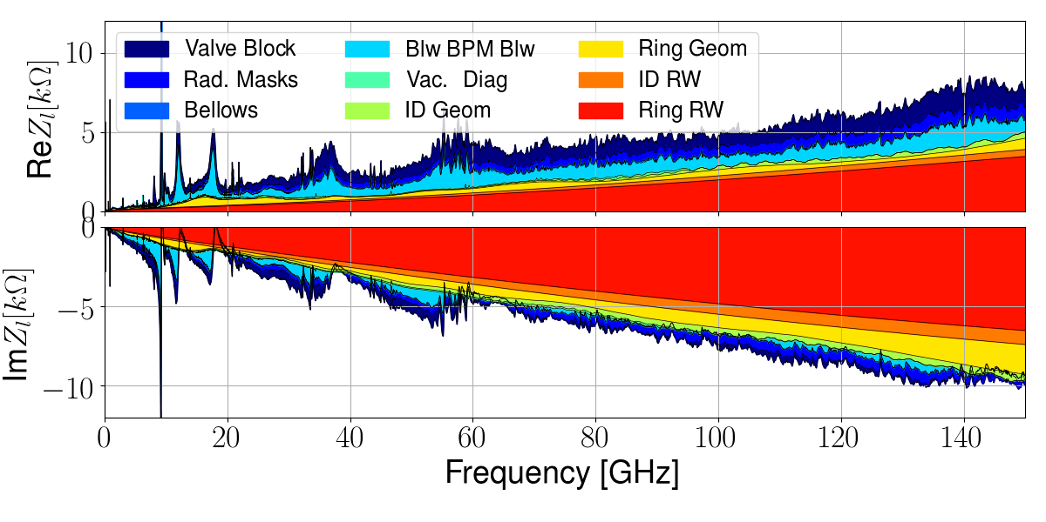
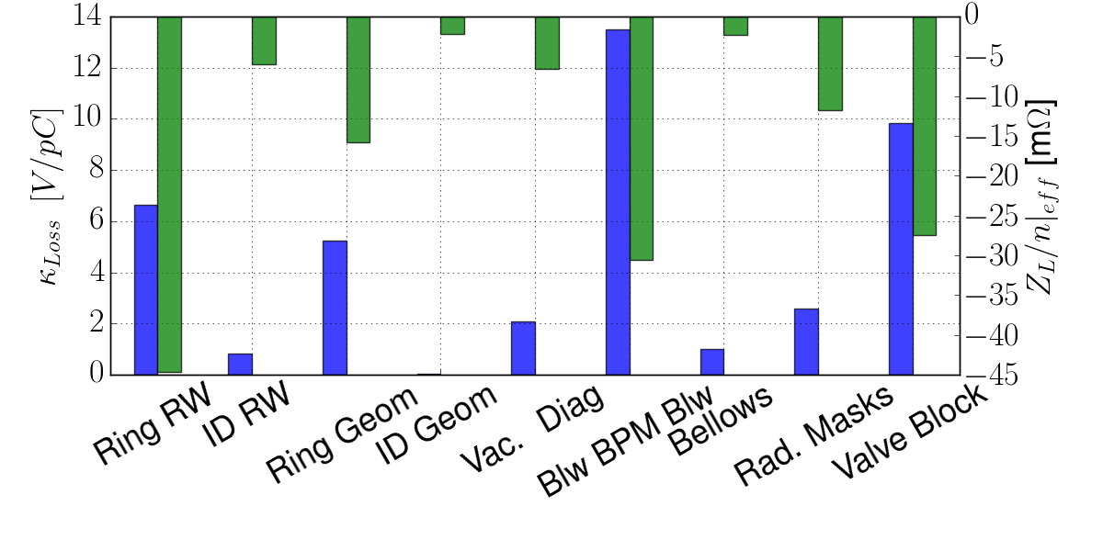
Longitudinal Impedance Budget
$$\frac{Z_{L}}{n}{\left.​\right|}_{eff} [mΩ]$$
-145.9
$κ_{Loss} \left[\frac{V}{pC}\right]$
41.8

Slide 5
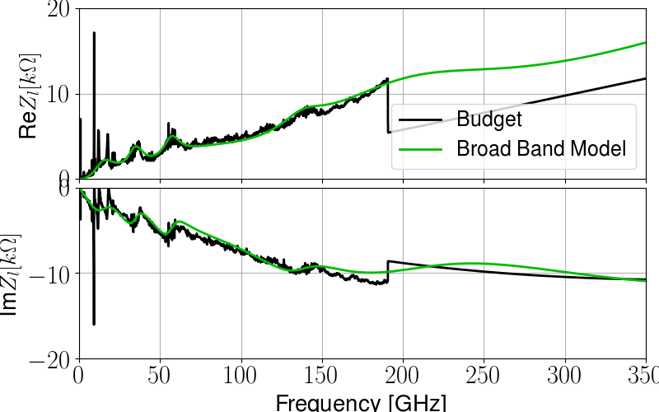
BBR Fitting
Creation of a model for the longitudinal impedance: Seven broad band resonators;
$$f_{r} [GHz]$$ | $$R_{s} [kΩ]$$ | $$Q$$
716.2 | 30 | 0.7
206.9 | 6.5 | 1.3
138.4 | 2.0 | 4
79.6 | 2.0 | 1
57.3 | 2.5 | 4.5
35.0 | 2.5 | 3
17.5 | 2.0 | 1
Figure: Longitudinal impedance of the Sirius budget and the impedance of a broad band model with seven resonators.

Slide 6
Longitudinal Instability analysis
Frequency domain:
Suzuki’s solution of the Linearized Vlasov-Fokker-Planck equation.
Stationary analysis:
Solution of the Haissinski equation;
Time domain:
Macro-particle tracking;

Slide 7
Frequency domain analysis
Suzuki solved the linearized Vlasov-Fokker-Planck equation considering a quadratic RF potential and not taking into account potential well distortion:
$$\left(\frac{Ω^{μ}}{ω_{s}} −m+i\frac{\left|m\right|+2l}{τ_{s}ω_{s}}\right)a_{m}^{l}=i\frac{I_{b}Mω_{0}η}{2π\left(\frac{E_{0}}{e}\right){\left(\frac{{ω_{s}σ}_{s}}{c}\right)}^{2}}\sum_{n,k }{{\left(N_{m,n}^{l,k}+O_{m,n}^{l,k}\right)a}_{n}^{k}}$$
Longitudinal
$$ω_{p}=ω_{0}\left(pM+μ+mν_{s}\right)$$
$$N_{m,n}^{l,k}=i^{m−n}m\sum_{p=−∞}^{∞}{\frac{Z^{L}\left(ω_{p}\right)}{ω_{p}}h_{ml}{\left(ω_{p}\right)h}_{nk}\left(ω_{p}\right)}$$
$$h_{ml}\left(ω\right)=\frac{{\left(\frac{ωσ_{s}}{\sqrt{2}c}\right)}^{\left|m\right|+2l}}{\sqrt{\left(\left|m\right|+l\right)!l!}}\exp\left(−{\left(\frac{ωσ_{s}}{√2c}\right)}^{2}\right)$$
Suzuki, T.; Part. Accel vol. 14, p. 91-108 (1983).

Slide 8
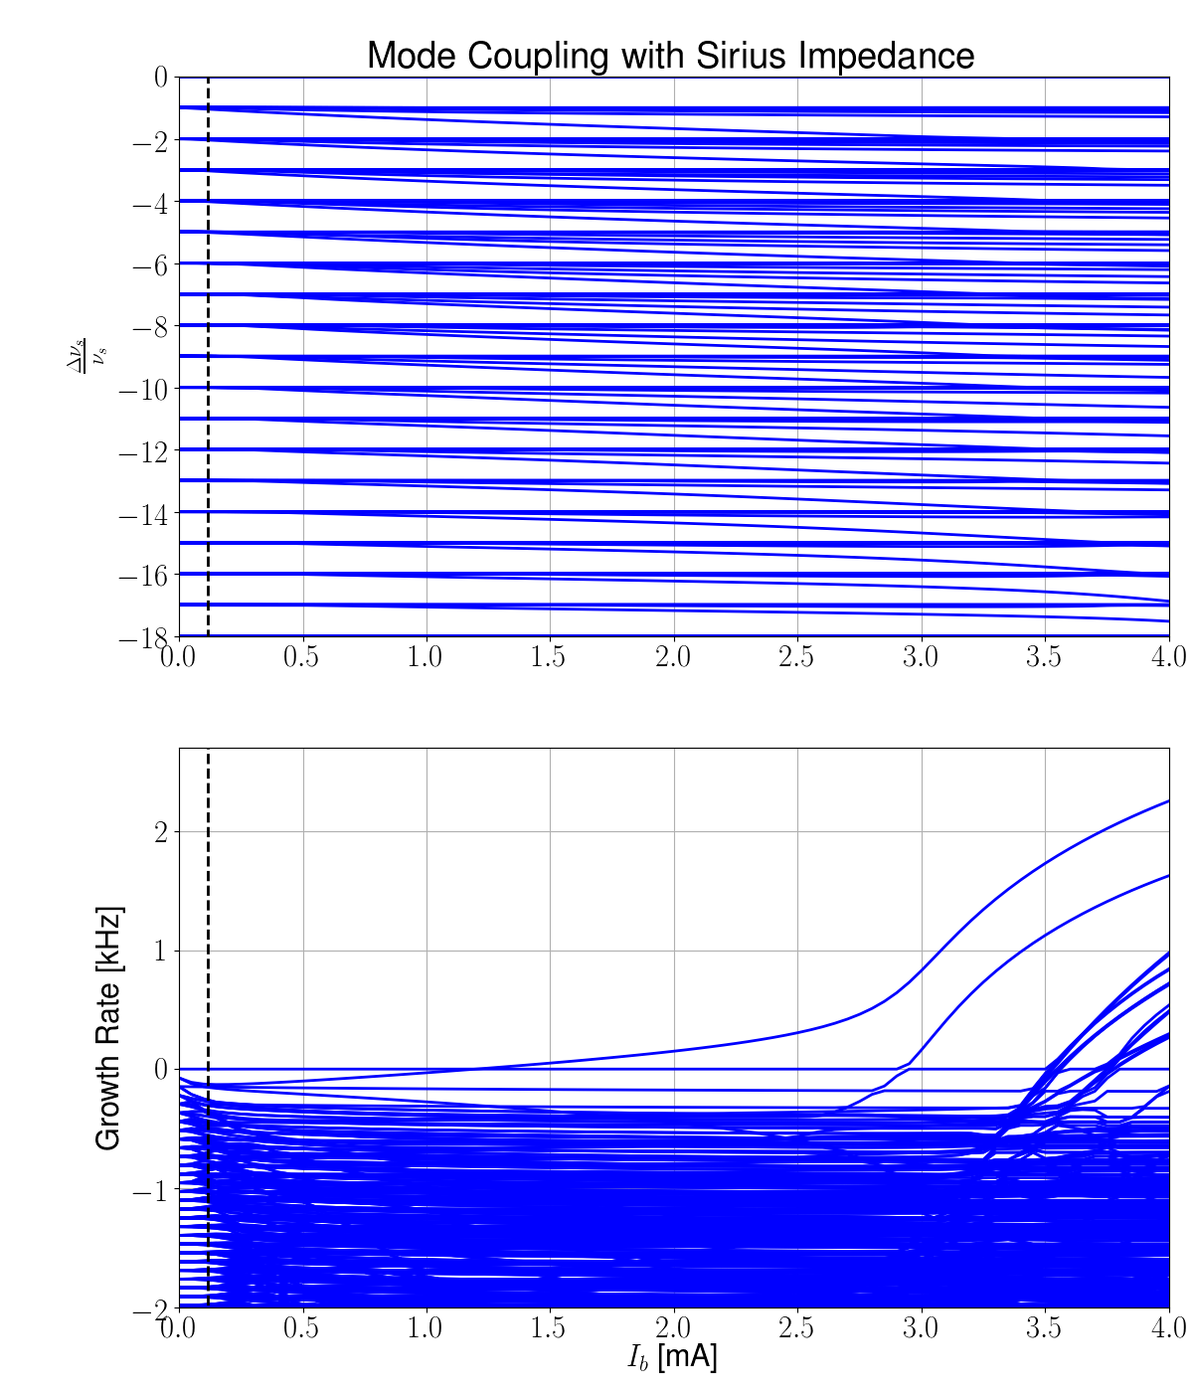
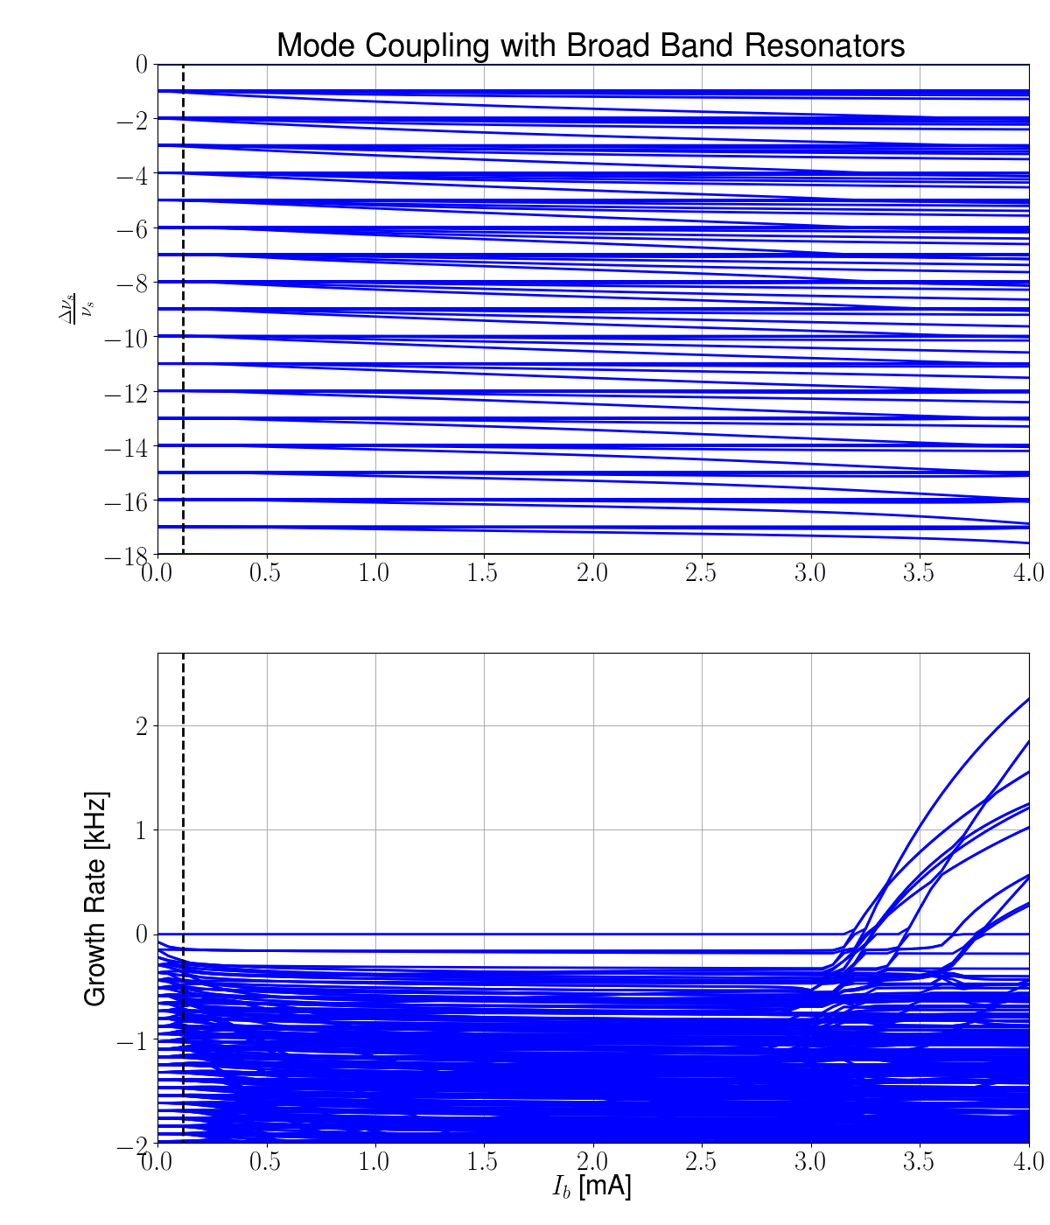
Frequency domain analysis
Figure: Longitudinal mode-coupling instability calculated with the longitudinal impedance of the Sirius budget for phase 1 of operation and the impedance of a broad band model with five resonators. Notice that the broad band model reproduces well most of the couplings between different azimuthal modes above 3.0 mA but fails to predict the radial mode coupling at very low current.

Slide 9
Haissinski Solution
Haissinski solutions for the broad band resonator model and the machine impedance. The agreement in bunch lengthening reflects the good fitting of the imaginary part of the impedance, while the divergence of the centroid of the bunch for the two solutions is an evidence of the poor fitting of the real part, mainly at low frequencies.

Slide 10
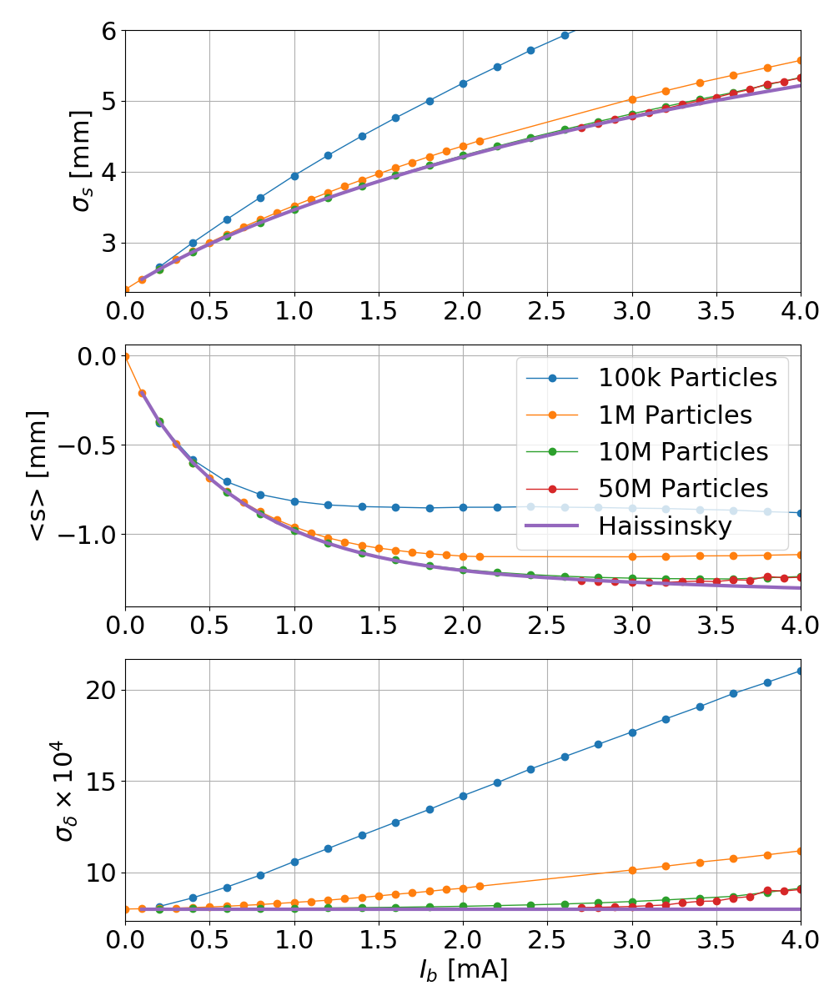
Macro Particle Tracking
Tracking results performed with the broad band model for the Sirius impedance, showing the effect of noise in simulation due to the reduced number of macro-particles used.
All tracking simulations presented in this work were perfomed with 50000 slices of the beam, where each slice has a longitudinal size of 2 um.

Slide 11
Possible reason of the energy spread increase
Suppose a wake that falls to zero in a distance $Δs$comparable to the to the distance one typical particle travels in one turn:
$$Δs≈4σ_{s}ν_{s}$$
For a bunch with $N_{p}$ macro-particles, the number of macro-particles in this interval ($N_{l}$) is a random variable following a binomial distribution with:
$$\left\langle N_{l}\right\rangle =ρ\left(s\right)Δs N_{p}$$
$$var(N_{l})≅ρ\left(s\right)Δs N_{p}$$
For a gaussian bunch and a particle close to $s=σ_{s}$:
$$ρ\left(σ_{s}\right)=\frac{e^{−0.5}}{\sqrt{2π}σ_{s}}$$
Which means that each turn the particles will receive random kicks ($K$) given by:
$$var(K)={\left(I_{b}T_{0}W\right)}^{2}\frac{var\left(N_{l}\right)}{N_{p}^{2}}≅{\left(I_{b}T_{0}W\right)}^{2}\frac{Δs}{{\sqrt{2πe}σ_{s}N}_{p}}$$
where $W$ is the strength of a flat model for the wake in the region, $I_{b}$ is the current in the bunch and $T_{0}$ is the revolution period.
These kicks will change the energy spread of the beam in the simulation:
$$Δσ^{2}= σ_{δ}^{2}−σ_{δ0}^{2}={\left(\frac{I_{b}T_{0}W}{E_{0}}\right)}^{2}\frac{Δs}{\sqrt{2πe}{σ_{s}N}_{p}}\frac{1}{α_{e}T_{0}(2−α_{e}T_{0})}$$

Slide 12
Possible reason of the energy spread increase
Scaling of the energy spread gain with the relevant parameters of the mechanism described before for several tracking simulations.

Slide 13
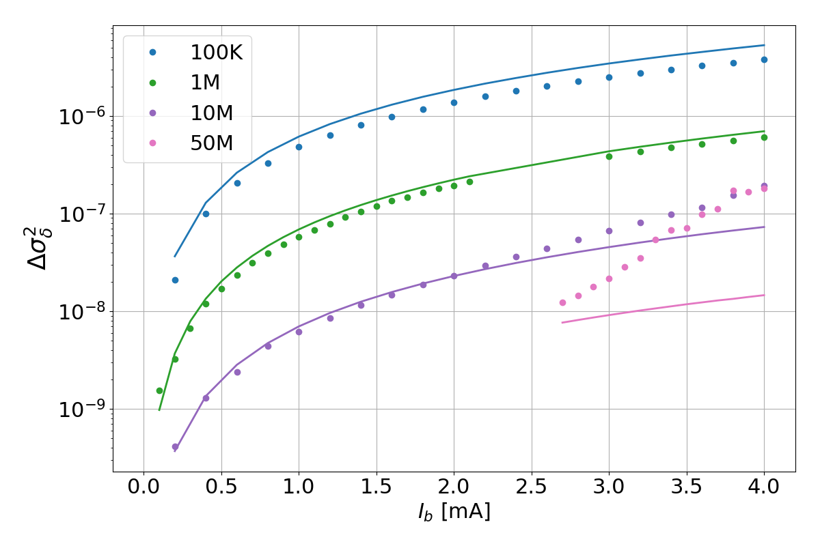
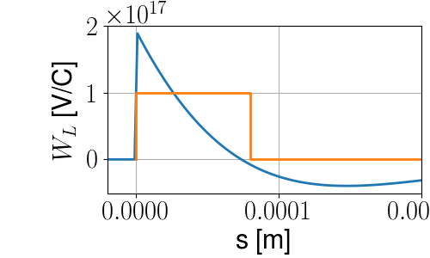
Possible reason of the energy spread increase
Square of energy spread increase in tracking (dots) and calculated using the formula of the last slide (solid) considering $W=1×{10}^{17}$ V/C and $Δs=80 μ$m.

Slide 14
Tracking comparisons

Slide 15
Tracking comparisons

Slide 16
Tracking comparisons

Slide 17
Can we do better?
$$f_{r} [GHz]$$ | $$R_{s} [kΩ]$$ | $$Q$$
716.2 | 30 | 0.7
206.9 | 6.5 | 1.3
138.4 | 2.0 | 4
79.6 | 2.0 | 1
57.3 | 2.5 | 4.5
35.0 | 2.5 | 3
17.5 | 1.7 | 1
17.8 | 3.0 | 24
11.9 | 4.0 | 24
9.2 | 20 | 100

Slide 18
Tracking comparisons (New BBR)

Slide 19
Tracking comparisons (New BBR)

Slide 20
Tracking comparisons (New BBR)

Slide 21
Evolution of energy distribution

Slide 22
Evolution of longitudinal distribution

Slide 23
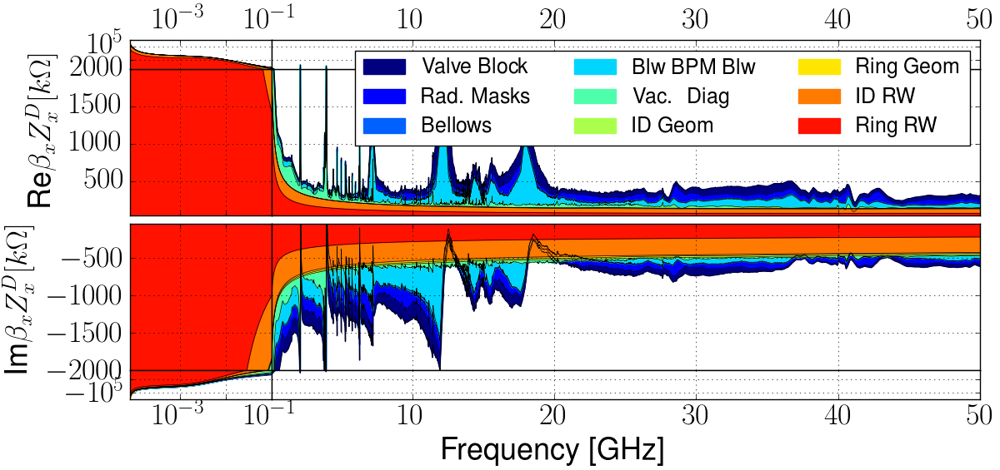
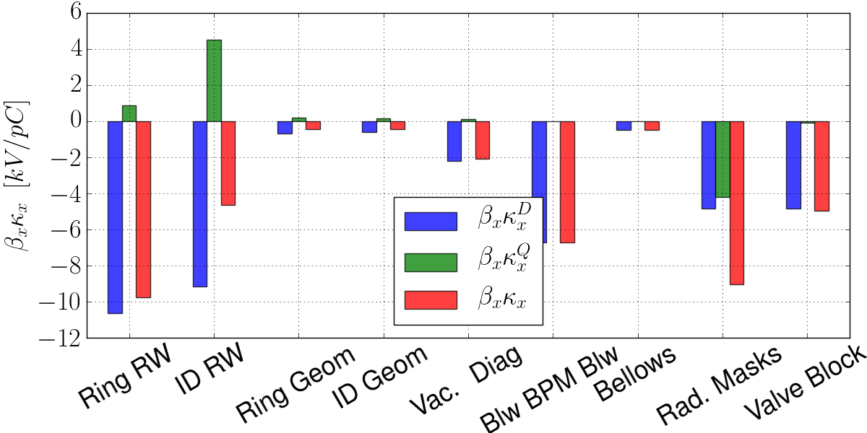
Horizontal Impedance Budget
 | $$\left[\frac{kV}{pC}\right]$$
$$κ_{x}^{D}$$ | -40.1
$$κ_{x}^{Q}$$ | 1.6
$$κ_{x}$$ | -38.6

Slide 24
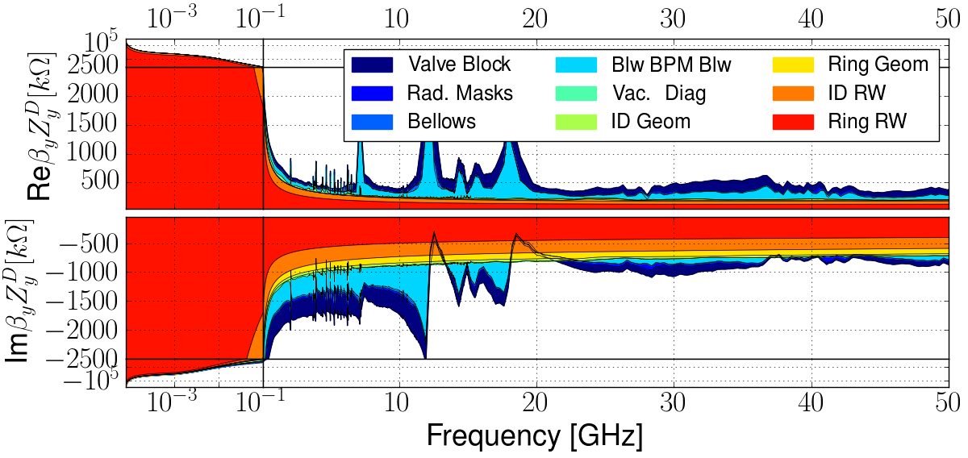
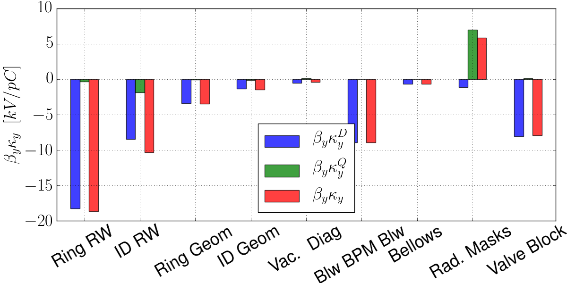
Vertical Impedance Budget
 | $$\left[\frac{kV}{pC}\right]$$
$$κ_{y}^{D}$$ | -50.9
$$κ_{y}^{Q}$$ | 4.8
$$κ_{y}$$ | -46.0

Slide 25
Frequency domain analysis
Suzuki solved the linearized Vlasov-Fokker-Planck equation considering a quadratic RF potential and not taking into account potential-well distortion and transverse tune spread:
$$\left(\frac{Ω^{μ}−ω_{x}}{ω_{s}} −m+i\left(\frac{1}{τ_{x}ω_{s}}+ \frac{\left|m\right|+2l}{τ_{s}ω_{s}}\right)\right)a_{m}^{l}=−i\frac{I_{b}Mω_{0}}{4π\left(\frac{E_{0}}{e}\right)ω_{s}}\sum_{n,k }{{\left(N_{m,n}^{l,k}+O_{m,n}^{l,k}\right)a}_{n}^{k}}$$
Transverse
$$ω_{p}=ω_{0}\left(pM+μ{+ ν}_{x}+mν_{s}\right)$$
$$N_{m,n}^{l,k}=i^{m−n}\sum_{p=−∞}^{∞}{\left\langle β\right\rangle {\left\langle Z^{T}\left(ω_{p}\right)\right\rangle }_{β}h_{ml}{\left(ω_{p}−\frac{ξ_{x}}{η}ω_{0}\right)h}_{nk}\left(ω_{p}−\frac{ξ_{x}}{η}ω_{0}\right)}$$
$$h_{ml}\left(ω\right)=\frac{{\left(\frac{ωσ_{s}}{\sqrt{2}c}\right)}^{\left|m\right|+2l}}{\sqrt{\left(\left|m\right|+l\right)!l!}}\exp\left(−{\left(\frac{ωσ_{s}}{√2c}\right)}^{2}\right)$$
Suzuki, T.; Part. Accel vol. 14, p. 79-96 (1986).

Slide 26
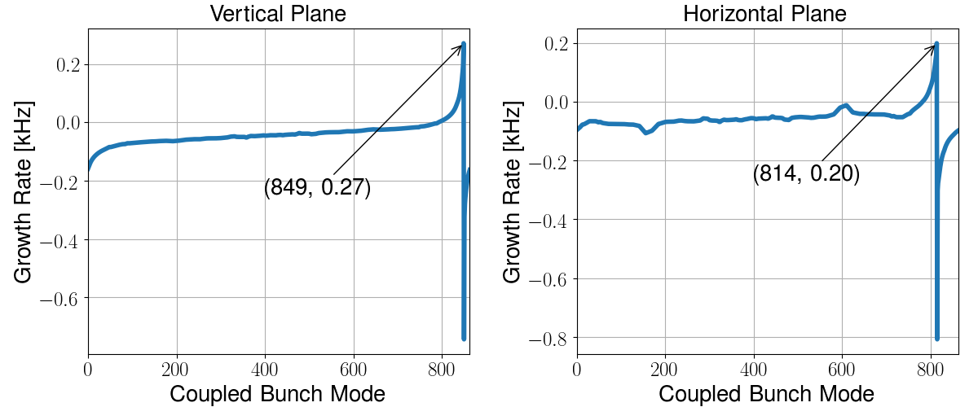
Coupled-Bunch Instability
$I_{th}$ [mA] @ $ξ=0$ | P0
Horizontal | 19
Vertical | 34

Slide 27
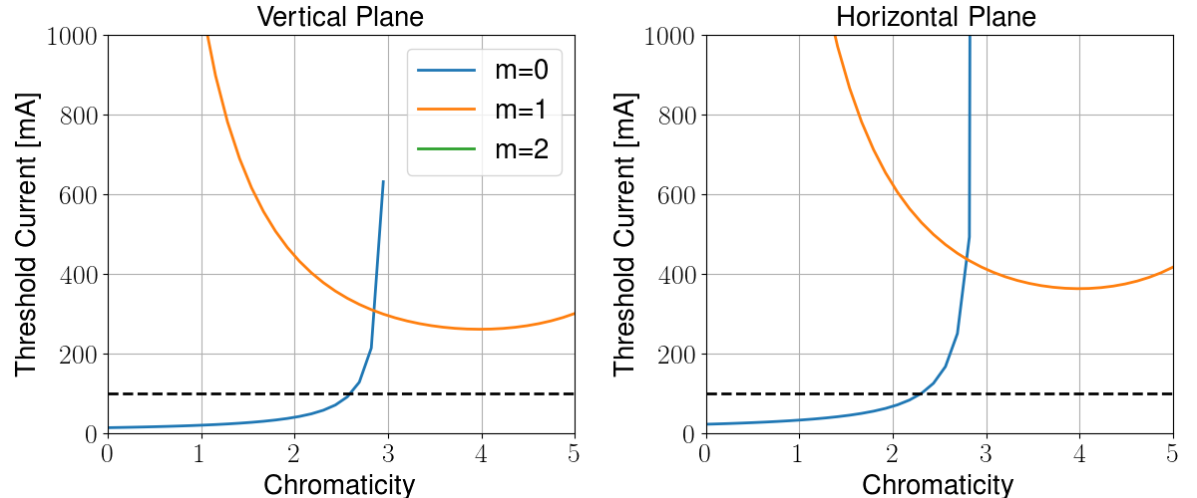
Chromatic dependence

Slide 28
Transverse mode-coupling Instability
Figure: Tranverse mode-coupling instability calculated with the impedance of the Sirius budget for phase 1 of operation, considering a 3.0 mm gaussian bunch.

Slide 29
Next Steps
Include CSR impedance in the longitudinal budget and study its effect on the instability threshold;
Perform tracking with transverse impedance and a bunch-by-bunch feedback system to study the transverse mode-coupling threshold;
Estimate instabilities in the considering bunch lengthening from a Landau cavity;
Extend the code to simulate multi-bunch wake kicks;

Slide 30
Conclusions
Good agreement between frequency domain and tracking results;
The haissinski solution as a function of the current predicts very well the tracking results below the instability treshold and is the perfect initial condition for tracking;
In the longitudinal plane it is not necessary to perform tracking below the threshold, and the frequency domain analysis provides a good hint about where the threshold is;
The formula for estimation of the effects of noise in tracking simulations is an important tool for defining the number of particles of the simulation and the characteristics of the filter to be applied to the wake;
The high frequency of the longitudinal wall impedance does not affect the beam behavior but its low frequency imaginary part is important to reproduce the bunch lengthening (for the case of Sirius this helps stabilizing the beam in the longitudinal plane);
Above the threshold the beam behavior depends very strongly on the real part of the low frequency impedance.

Slide 31
Acknowledgements
Thanks to:
Ryutaro Nagaoka and Gabrieli Bassi for the fruitful discussions on instabilities;
All the members of the Accelerator Physics Group for the support throughout this work and all the educated guesses;
Ximenes Resende and Guilherme Prado for their help in the development of the tracking code;
Luana Vilela for helping with the preparation of this presentation, the poster and the travel arrangements;
The organizers for the invitation and the gracious reception;
Grazie mille per l’attenzione!

Slide 32
Extra Slides

Slide 33
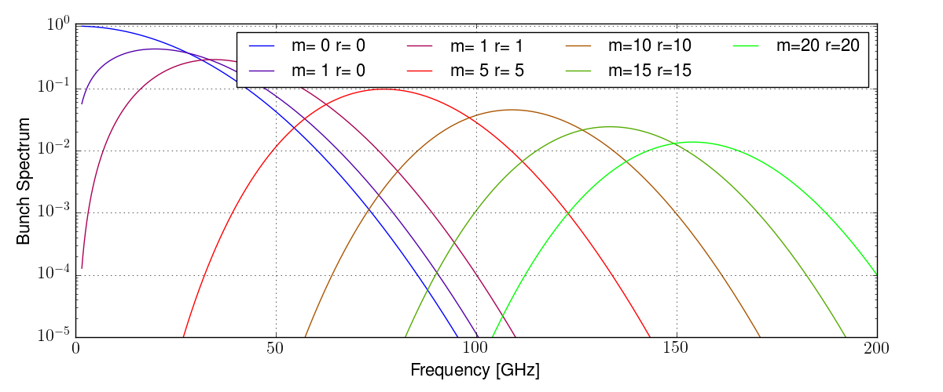
Sirius main parameters
Gaussian bunch spectrum for several azimuthal (m) and radial (r) modes.
Transverse
Longitudinal
$m,r<3 and f_{ξ}=\frac{ξ}{η}f_{0}≈34 GHz$
$$for ξ=10 ⇒ |f|<100 GHz$$
$m,r \sim 10 ⇒ |f|<130 GHz$

Slide 34
Haissinski Solver
Given the Haissinski operator:
$$Ⅎ(ρ,s)=Bexp\left(\frac{1}{ηCE_{0}σ_{δ}^{2}}\left(U_{cav}\left(s\right)−I_{b}T_{0}\int_{−∞}^{∞}{W\left(s−s^{′}\right)ρ\left(s^{′}\right)ds^{′}}\right)\right), B ∈ℜ | \int_{−∞}^{∞}{Ⅎ(ρ,s)ds}=1$$
we want to find: $ρ= Ⅎ(ρ,s).$
Start with low current $I_{b}$ and iterate:
$$ρ_{0}^{I_{b}}\left(s\right)=Aexp\left(\frac{U_{cav}\left(s\right)}{ηCE_{0}σ_{δ}^{2}}\right), A ∈ℜ | \int_{−∞}^{∞}{ρ_{0}^{I_{b}}\left(s\right)ds}=1$$
$$ρ_{1}^{I_{b}}\left(s\right)=Ⅎ\left(ρ_{0},s\right), n≥2: ρ_{n+1}^{I_{b}}\left(s\right)=Ⅎ\left(\frac{ρ_{n}^{I_{b}}+{αρ}_{n−1}^{I_{b}}}{1+α},s\right), α≥0∈ℜ$$
Until convergence:
$\left\|ρ_{n+1}^{I_{b}}−ρ_{n}^{I_{b}}\right\|<1×{10}^{−6} ⇒ ρ^{I_{b}}=ρ_{n+1}^{I_{b}}$, where $\left\|⋅\right\|=\int_{−∞}^{∞}{{(⋅)}^{2}ds}$
Increment the current $I_{b}+ΔI$ and repeat the process using $ρ_{0}^{I_{b}+ΔI}$=${ ρ}^{I_{b}}$

Slide 35
Macro-particle tracking code
Simple 4D ($x\left|y, x^{′}\right|y^{′},δ, s$) one turn matriz with linear chromaticity and tune shift with Amplitude;
Cavity kick as interpolation table (general potential well);
Damping and gaussian noise in energy and angle to simulate quantum excitation;
Single bunch wake kick. Two methods for kick calculation:
Resonators:
parameters for an arbitrary number ($N_{R}$) of resonators can be given;
kicks are calculated using particle sorting and potential storing for each resonator, starting from the particle ahead;
Does not require beam slicing (execution time$∝N_{R}N_{p}ln⁡(N_{p})$);
Wakes as interpolation tables:
Particle deposition is done at the $N_{s}$ longitudinal points defined by the wake;
Convotution theorem is used to calculate the kick curve¹ (execution time$∝N_{s}ln⁡(N_{s})|N_{p}$);
Kicks are applied by linear interpolation;
Paralelized for shared memory systems;
¹Bassi, G. Et al; Phys. Rev. AB 19, 024401 (2016).

Slide 36
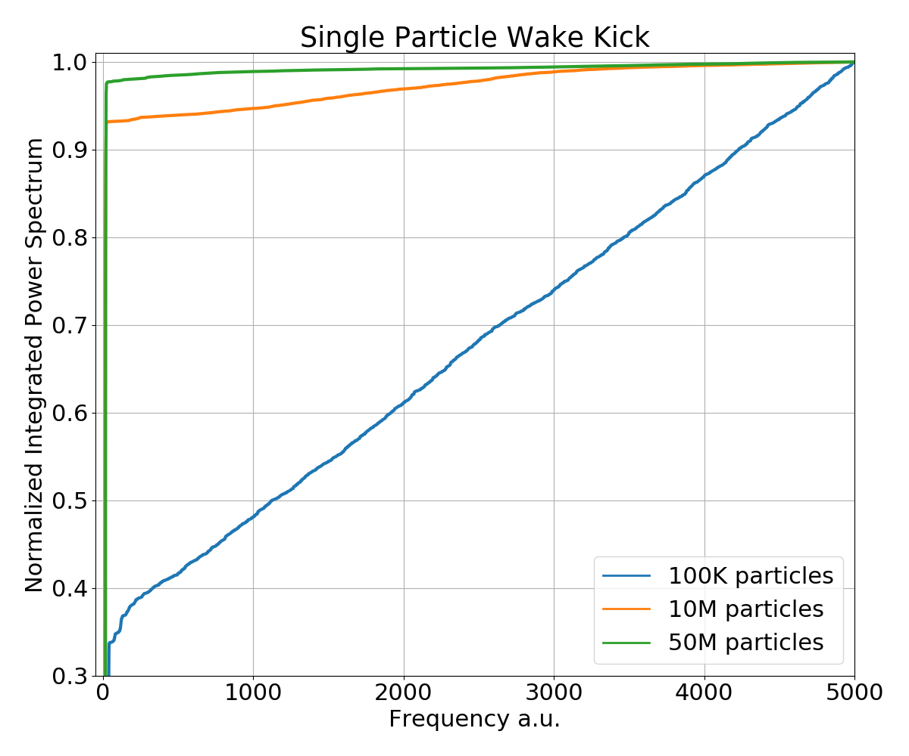
Macro Particle Tracking (single particle analysis)
During tracking simulations one particle is followed and its position in phase space and kick received by the wake are stored for each turn. The figure above shows the integrated power spectrum of the kick as a function of the frequency for simulations with 4 mA in the bunch. As the number of particles simulated increase, the energy is concentrated in the synchrotron frequency.

